Slide 1
Generellem
A Technical Overview

Slide 2
Overview
Purpose
Architecture
Project Organization
Client Implementation
Questions

Slide 3
Purpose
Lets anyone use their own data with LLMs
Can have current access to your own IP
Flexible framework lets you choose services

Slide 4
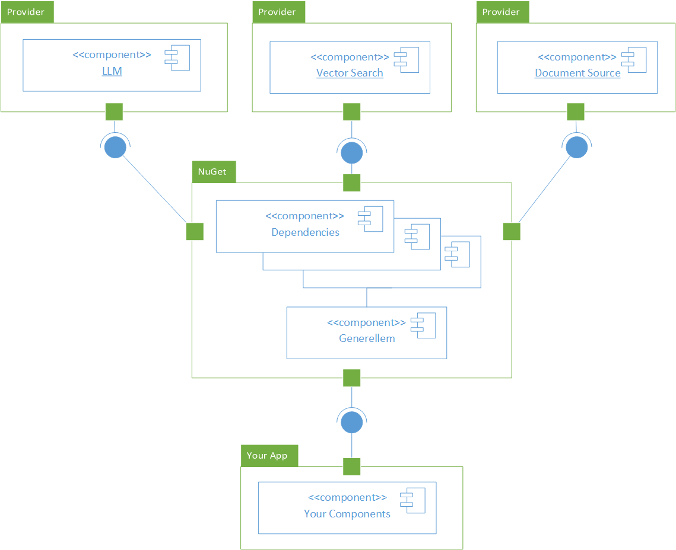
Architecture

Slide 5
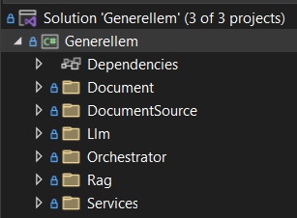
Project Organization

Slide 6
Client Implementation
Uses Microsoft.Extensions.Hosting
Uses HostApplicationBuilder.Services for IoC
Supports IConfiguration

Slide 7
;
Questions?

